Slide 1
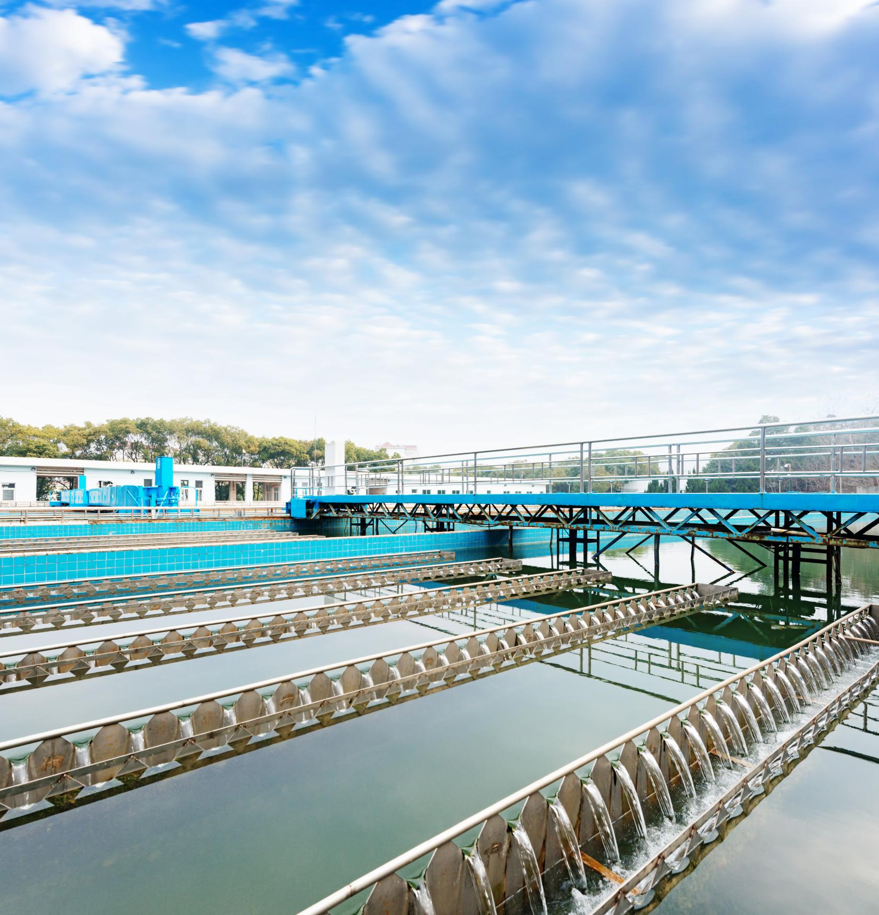
Water and Sewage Treatment Guide
Essential processes for clean and safe water
Notes:
AI-generated content may be incorrect. ---

Slide 2
Water & Sewage Treatment Overview
Notes:
--- This slide references information from the following file: https://d.docs.live.net/12CB43E2CA5F0D2C/Microsoft%20Copilot%20Chat%20Files/presentation.html From Source to Safe Disposal

Slide 3
From Source to Safe Disposal
Water Filtration Methods
Various filtration methods like slow sand and rapid sand filtration ensure clean water for diverse conditions.
Advanced Filtration Technologies
Solar-powered and household multi-stage filtration systems address modern water scarcity and contamination issues.
Sewage Treatment Process
Sewage treatment plants remove pollutants and pathogens to protect environment before water reuse or discharge.
Notes:
--- This slide references information from the following file: https://d.docs.live.net/12CB43E2CA5F0D2C/Microsoft%20Copilot%20Chat%20Files/presentation.html Water and sewage treatment is a critical process that ensures safe drinking water and environmentally responsible disposal of wastewater. The journey begins at the source, where raw water is collected, and continues through various stages of filtration and purification before reaching consumers or being discharged safely. This comprehensive guide covers multiple treatment methods, including slow sand filtration, rapid sand filtration, solar-powered systems, household filtration techniques, and sewage treatment plants (STPs). Each method has unique operational principles, efficiency levels, and suitability for different contexts such as rural, urban, or emergency situations. Understanding these processes is essential for public health, sustainability, and resource management. The guide also emphasizes the importance of integrating advanced technologies like solar-powered filtration and multi-stage household systems to address modern challenges in water scarcity and contamination. Additionally, sewage treatment processes are explained in detail, highlighting their role in reducing pollutants, pathogens, and organic matter from wastewater before reuse or discharge. By exploring these topics, readers gain insights into cost considerations, energy requirements, maintenance needs, and practical applications, enabling informed decisions for implementing effective water and sewage treatment solutions.

Slide 4
Slow Sand Filter (SSF)
Notes:
--- This slide references information from the following file: https://d.docs.live.net/12CB43E2CA5F0D2C/Microsoft%20Copilot%20Chat%20Files/presentation.html Process and Efficiency

Slide 5
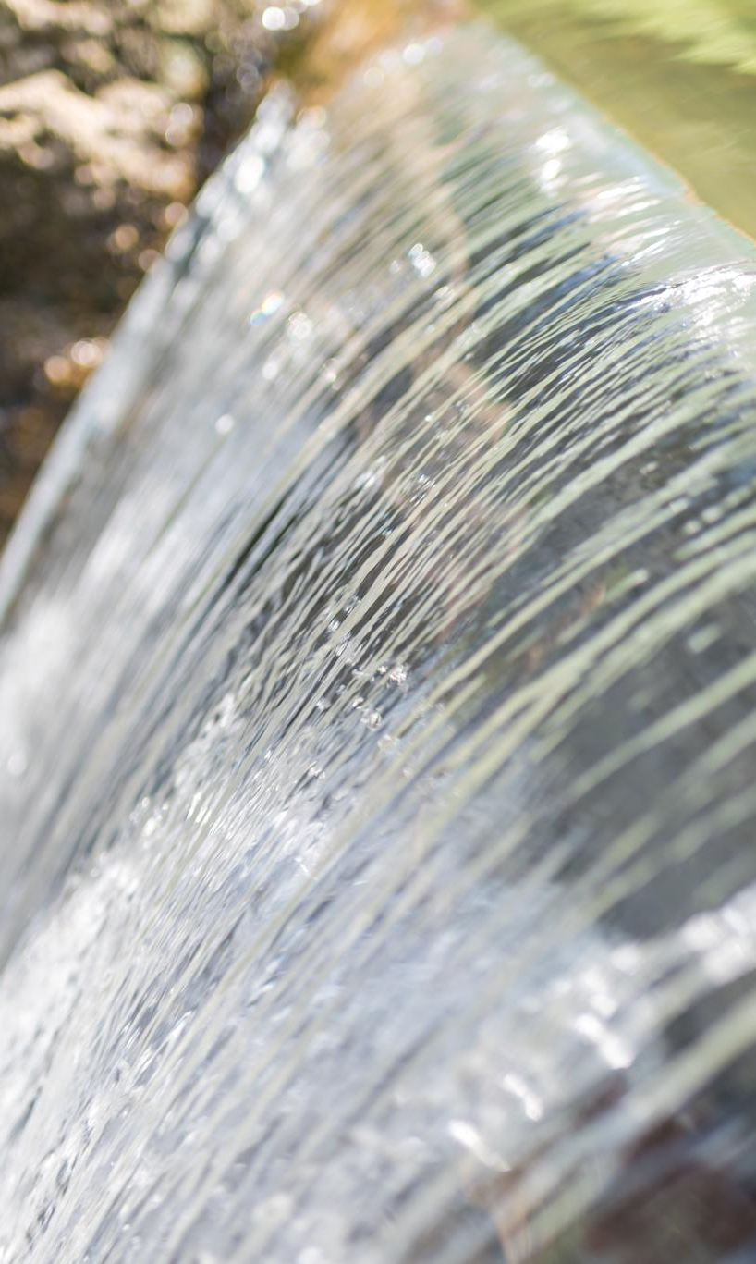
Process and Efficiency
Gravity-Driven Filtration
SSF uses gravity and fine sand to filter contaminants without requiring pumps or energy.
Biological Layer Action
Schmutzdecke layer naturally forms on sand surface and eliminates pathogens via biological processes.
High Efficiency and Purification
SSF achieves 90–99% bacterial reduction and removes solids, microorganisms, and heavy metals effectively.
Suitability for Remote Areas
Minimal maintenance and no chemical pre-treatment make SSF ideal for rural communities with limited resources.
•Slow Sand Filter Demo (Video)
•SSF Animation
Notes:
--- This slide references information from the following file: https://d.docs.live.net/12CB43E2CA5F0D2C/Microsoft%20Copilot%20Chat%20Files/presentation.html The Slow Sand Filter (SSF) is a gravity-driven filtration system that uses fine sand with a grain size of 0.2–0.4 mm to remove contaminants from water. Its operation relies on a biological layer called Schmutzdecke, which forms naturally on the sand surface and plays a crucial role in pathogen removal through biological action. SSF systems are highly efficient, achieving 90–99% bacterial reduction while also removing solids, microorganisms, and heavy metals. These filters are particularly suitable for rural and remote areas due to their low energy requirements, as they operate without pumps and depend solely on gravity. Maintenance is minimal, and the system does not require chemical pre-treatment, making it cost-effective and environmentally friendly. The filtration process typically takes 24–72 hours, ensuring thorough purification. SSF is ideal for communities with limited resources, offering a sustainable solution for safe drinking water. Its simplicity and reliability make it a preferred choice in developing regions where infrastructure and technical expertise may be limited.

Slide 6
Rapid Sand Filter (RSF)
Notes:
--- This slide references information from the following file: https://d.docs.live.net/12CB43E2CA5F0D2C/Microsoft%20Copilot%20Chat%20Files/presentation.html Process and Operational Features

Slide 7
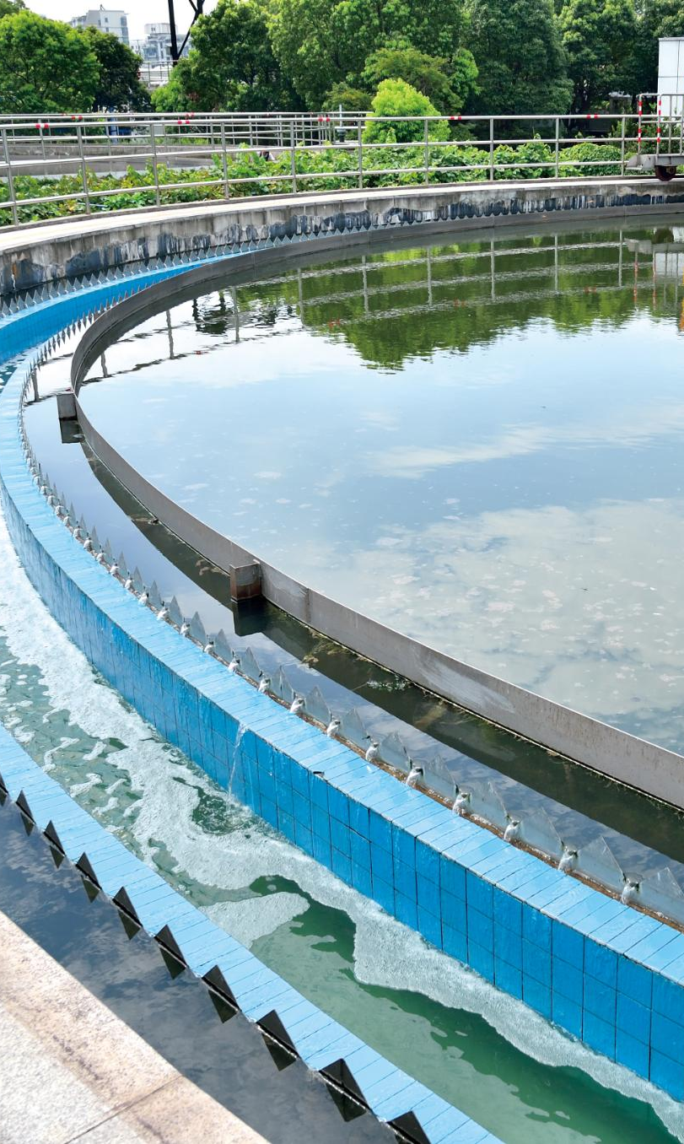
Process and Operational Features
High-Flow Mechanical Filtration
RSF uses sand grains sized 0.4–0.7 mm for efficient high-flow filtration in water treatment.
Multi-Stage Treatment Process
The process includes coagulation, flocculation, sedimentation, and rapid filtration for effective contaminant removal.
Operational Complexity and Maintenance
RSF requires regular backwashing and chemical use, increasing energy consumption and operational demands.
Application and Efficiency
RSF operates at 5–15 m³/m²/hr filtration rate with 95–98% pathogen removal, ideal for large urban facilities.
•RSF Animation
•SSF vs RSF Comparison
Notes:
--- This slide references information from the following file: https://d.docs.live.net/12CB43E2CA5F0D2C/Microsoft%20Copilot%20Chat%20Files/presentation.html Rapid Sand Filters (RSF) are designed for high-flow mechanical filtration using sand grains sized between 0.4–0.7 mm. Unlike SSF, RSF systems require chemical pre-treatment through coagulation and flocculation to aggregate fine particles before filtration. The process involves multiple stages: coagulation, flocculation, sedimentation, and rapid filtration. RSF operates at a filtration rate of 5–15 m³/m²/hr, significantly faster than SSF, making it suitable for urban areas and large municipalities. However, RSF systems require regular backwashing every 5–15 days to maintain efficiency, which increases operational complexity and energy consumption due to the need for pumps. While RSF achieves pathogen removal rates of 95–98%, its reliance on chemicals and frequent maintenance makes it more resource-intensive compared to SSF. Despite these challenges, RSF remains a popular choice for large-scale water treatment facilities where speed and capacity are critical.

Slide 8
SSF vs RSF Comparison
Notes:
Operational Parameters, Practical Comparison

Slide 9
Operational Parameters •Comparison Video
Parameter | Slow Sand Filter | Rapid Sand Filter
Flow Rate | 0.1–0.3 m³/m²/hr | 5–15 m³/m²/hr
Sand Size | 0.2–0.4 mm | 0.4–0.7 mm
Filtration Duration | 24–72 hours | 2–8 hours
Backwashing | Not required | Every 5–15 days
Pre-treatment | None needed | Coagulation + Flocculation
Pathogen Removal | 90–99% | 95–98%
Energy Requirement | Nil (gravity) | Pumps required

Slide 10
Practical Comparison Comparison Video | SSF Demo | RSF Animation
Aspect | Slow Sand Filter | Rapid Sand Filter
Capital Cost | Low–Medium | High
Maintenance | Minimal (annual) | Frequent (weekly/monthly)
Space Required | Large | Compact
Skill Level | Low (simple) | Medium–High (trained)
Best Applications | Rural, remote, small communities | Urban, large municipalities
Chemical Usage | Minimal | Coagulants + disinfection
Lifespan | 10–20 years | 8–15 years

Slide 11
Advanced and Household Filtration
Notes:
--- This slide references information from the following file: https://d.docs.live.net/12CB43E2CA5F0D2C/Microsoft%20Copilot%20Chat%20Files/presentation.html Solar-Powered Water Filtration, Household Water Filtration

Slide 12
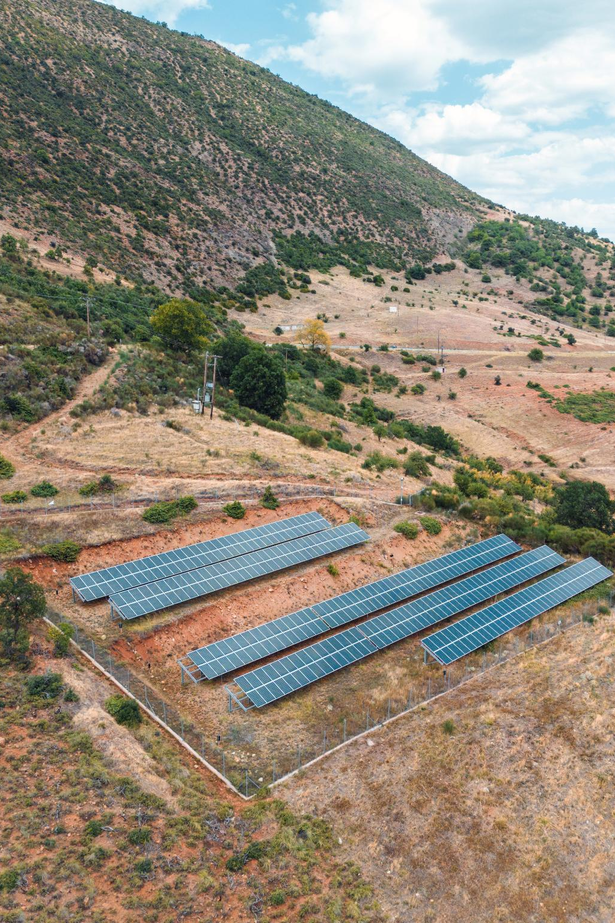
Solar-Powered Water Filtration
Solar Energy Conversion
Photovoltaic panels convert sunlight into electricity, powering pumps and UV lamps for water purification.
Filtration Techniques
Systems combine solar UV disinfection, reverse osmosis, and evaporation-condensation to remove contaminants effectively.
Applications and Benefits
Ideal for rural, off-grid, and emergency use, offering sustainability and reducing reliance on fossil fuels.
DIY Solar Filter | Solar Purifier System
Notes:
--- This slide references information from the following file: https://d.docs.live.net/12CB43E2CA5F0D2C/Microsoft%20Copilot%20Chat%20Files/presentation.html Solar-powered water filtration systems utilize photovoltaic panels to convert sunlight into electricity, powering pumps and UV lamps for purification. These systems often combine methods such as solar UV disinfection, reverse osmosis, and evaporation-condensation to remove contaminants. They are ideal for rural, off-grid, and emergency situations where conventional power sources are unavailable. Solar filtration offers sustainability and resilience, reducing dependency on fossil fuels and ensuring access to clean water in remote areas.

Slide 13
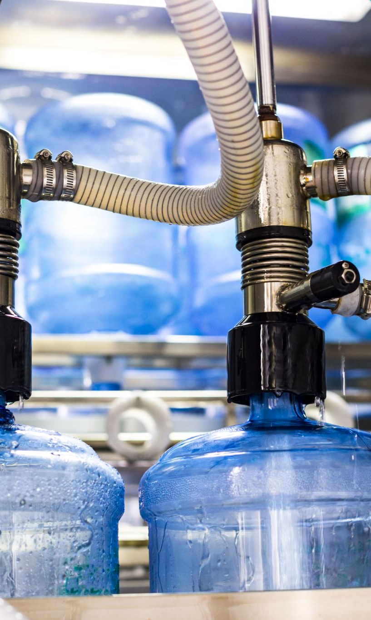
Household Water Filtration
Multi-stage Filtration Process
Household systems use sand, gravel, activated charcoal, and ceramic filters for effective water purification.
Activated Carbon Benefits
Activated carbon removes chlorine, sediments, VOCs, and odors improving water quality significantly.
Reverse Osmosis Removal
Reverse osmosis systems effectively eliminate heavy metals, fluoride, and nitrates from drinking water.
DIY Filtration Options
Affordable DIY filters like bottle-based or gravity-fed provide point-of-use water purification solutions.
5-Stage DIY Filter | Genius Quick Setup Filter
Notes:
--- This slide references information from the following file: https://d.docs.live.net/12CB43E2CA5F0D2C/Microsoft%20Copilot%20Chat%20Files/presentation.html Household water filtration systems typically employ multi-stage processes involving sand, gravel, activated charcoal, and ceramic filters. Activated carbon is effective in removing chlorine, sediments, volatile organic compounds (VOCs), and odors, while reverse osmosis systems eliminate heavy metals, fluoride, and nitrates. DIY options such as bottle-based or gravity-fed filters provide affordable solutions for point-of-use purification. These systems are essential for ensuring safe drinking water in homes, especially in areas with unreliable municipal supply.

Slide 14
Sewage Treatment Plant (STP)
Notes:
--- This slide references information from the following file: https://d.docs.live.net/12CB43E2CA5F0D2C/Microsoft%20Copilot%20Chat%20Files/presentation.html Overview and Stages, Primary, Secondary, and Tertiary Treatment

Slide 15
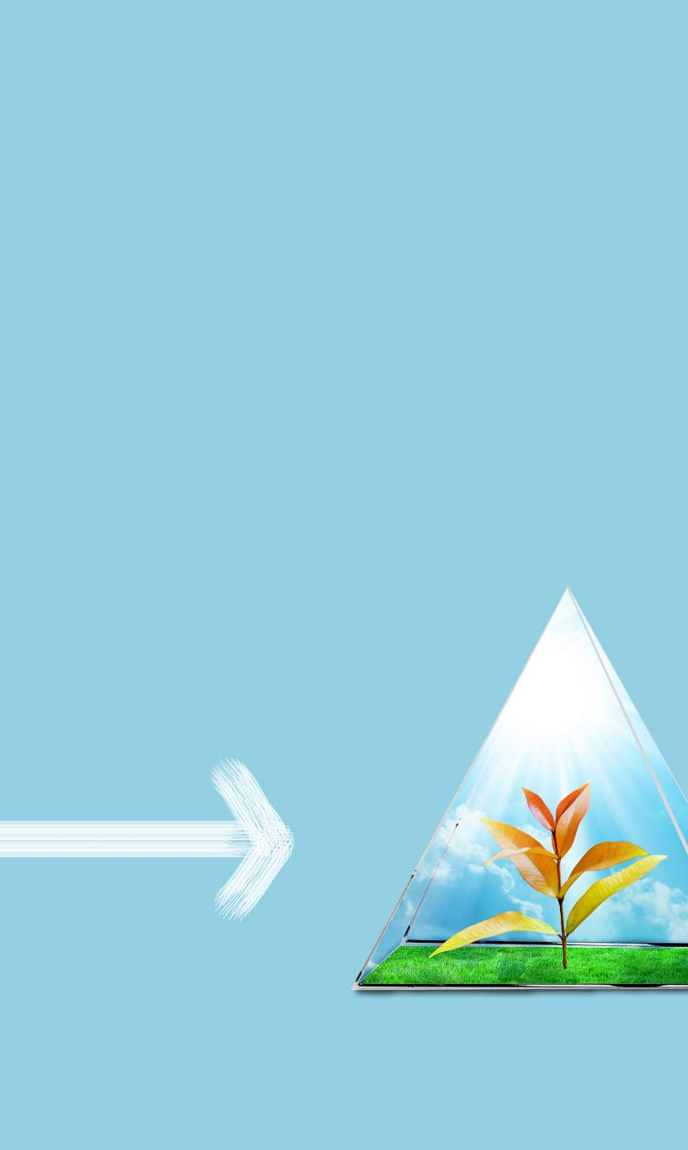
Overview and Stages
Preliminary and Primary Treatment
Initial stages remove large solids and grit, followed by sedimentation to separate sludge from wastewater.
Secondary Biological Treatment
Microorganisms biologically degrade organic matter to purify wastewater effectively.
Tertiary Treatment and Disinfection
Advanced nutrient removal and disinfection ensure the effluent is safe for discharge or reuse.
Sludge Management
Sludge is thickened, digested, dewatered, and disposed of safely to minimize environmental impact.
Sewage Treatment Animation | How STP Works
Notes:
--- This slide references information from the following file: https://d.docs.live.net/12CB43E2CA5F0D2C/Microsoft%20Copilot%20Chat%20Files/presentation.html Sewage Treatment Plants (STPs) are designed to remove solids, organic matter, pathogens, and nutrients from wastewater before discharge or reuse. The process involves multiple stages: preliminary treatment (screening and grit removal), primary treatment (sedimentation and sludge removal), secondary treatment (biological processes using microorganisms), and tertiary treatment (advanced nutrient removal and disinfection). Sludge management includes thickening, digestion, dewatering, and disposal through drying beds or composting. These steps ensure that treated effluent meets environmental standards and minimizes health risks.

Slide 16
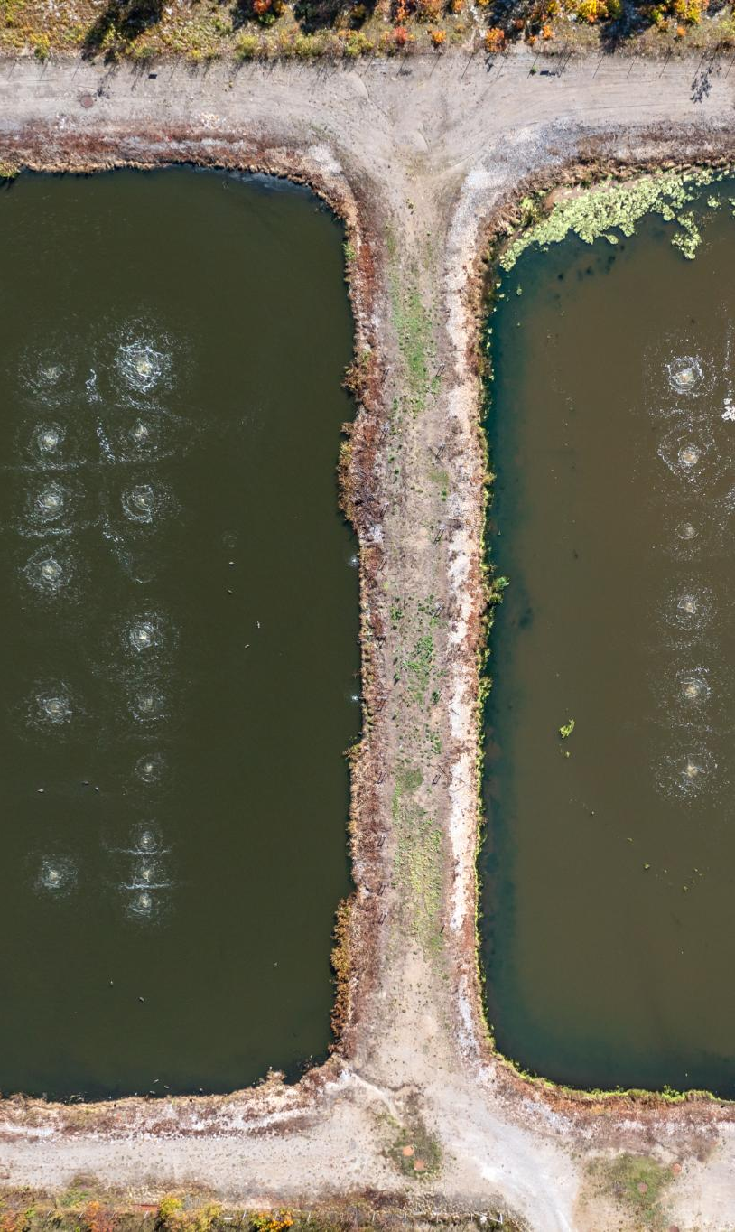
Primary, Secondary, and Tertiary Treatment
Primary Treatment Basics
Removes large debris and sediments via screening and sedimentation, reducing BOD by around 30%.
Secondary Biological Treatment
Uses biological processes like activated sludge and trickling filters to break down organics reducing BOD by 85–90%.
Tertiary Advanced Treatment
Employs advanced methods such as UV or chlorine disinfection to remove nutrients and pathogens effectively.
Sludge Management
Stabilizes and disposes sludge safely to minimize environmental impact during wastewater treatment.
STP Process Animation, Full STP Process Video
Notes:
--- This slide references information from the following file: https://d.docs.live.net/12CB43E2CA5F0D2C/Microsoft%20Copilot%20Chat%20Files/presentation.html Primary treatment focuses on removing large debris and sediments through screening and sedimentation, achieving about 30% reduction in Biochemical Oxygen Demand (BOD). Secondary treatment employs biological processes such as activated sludge systems and trickling filters to break down organic matter, reducing BOD by 85–90%. Tertiary treatment involves advanced methods to remove remaining nutrients and pathogens, often using UV or chlorine disinfection. Sludge generated during these processes undergoes stabilization and disposal, ensuring safe handling and minimizing environmental impact.

Slide 17
Key Filter Comparison and Summary
Notes:
--- This slide references information from the following file: https://d.docs.live.net/12CB43E2CA5F0D2C/Microsoft%20Copilot%20Chat%20Files/presentation.html Filter Types and Applications

Slide 18
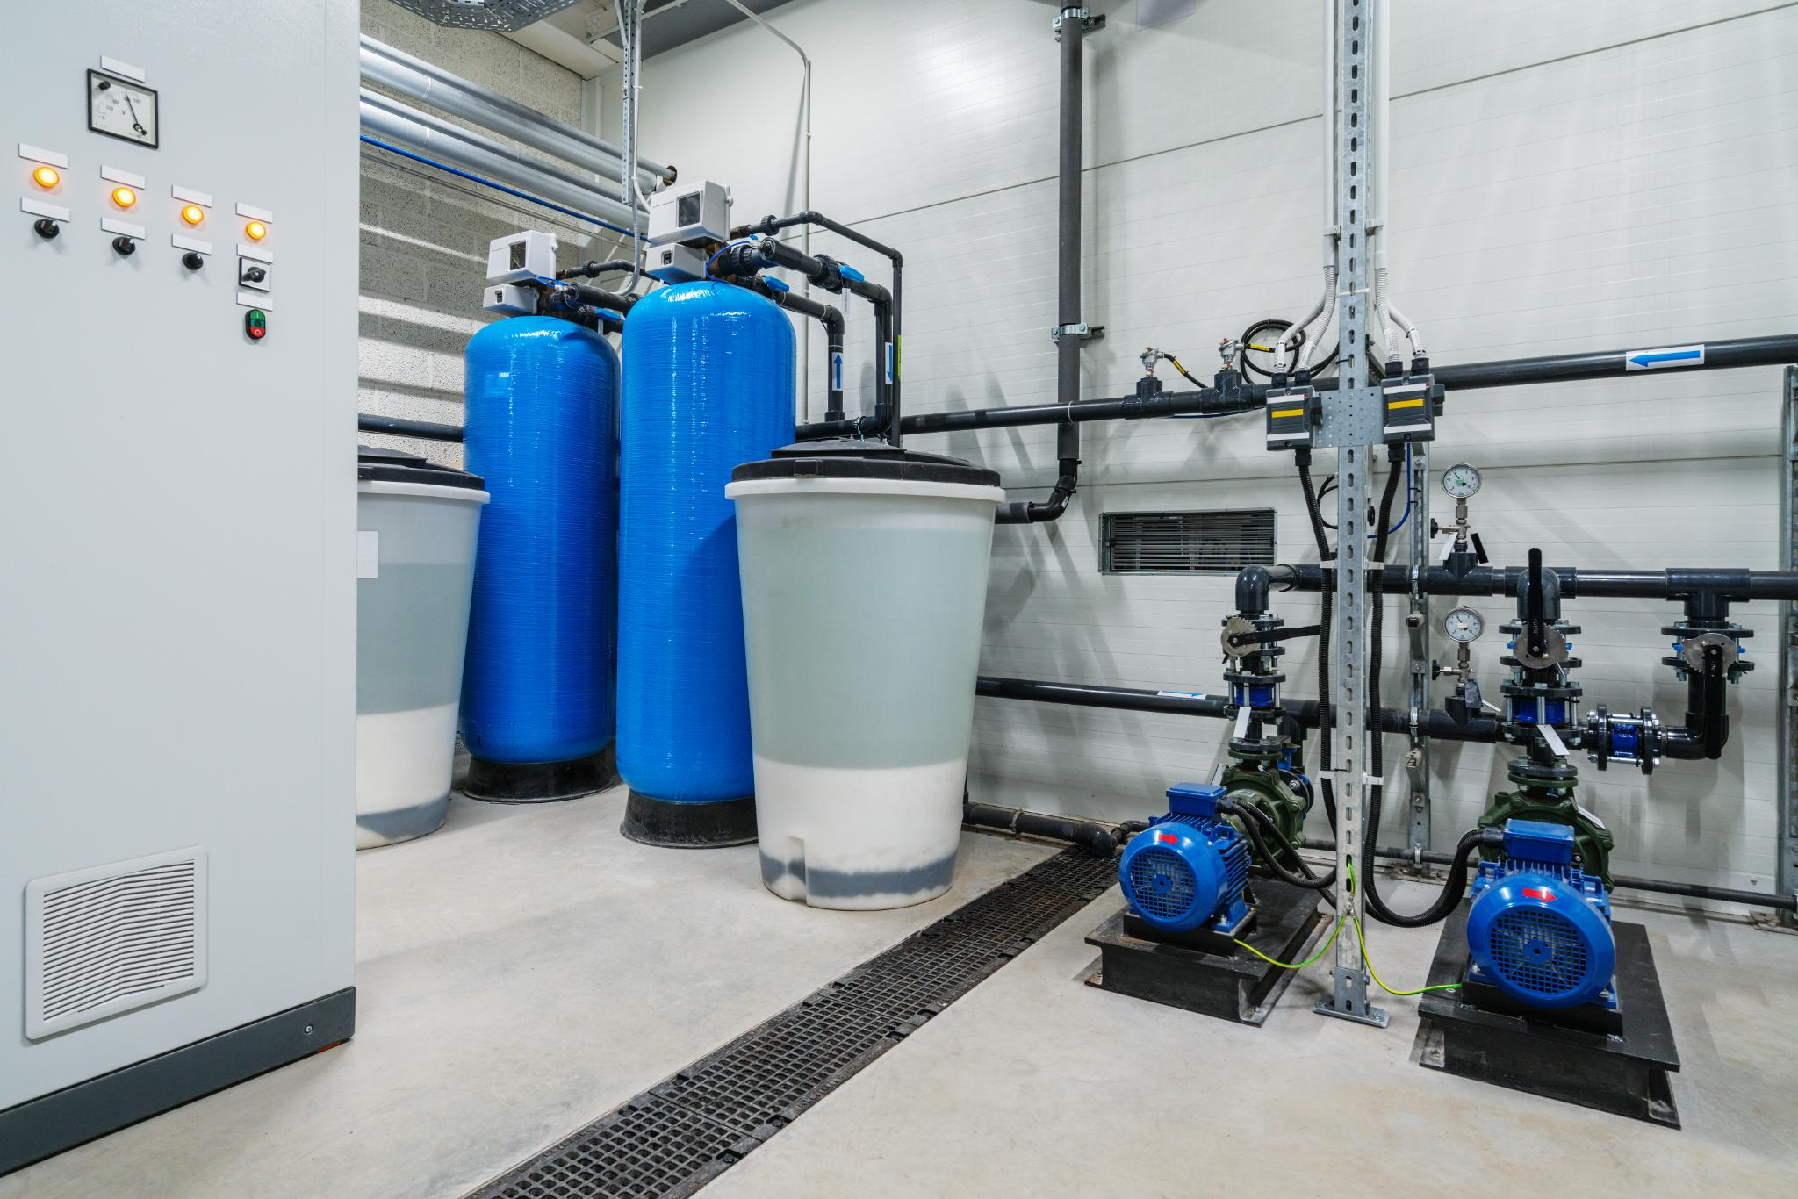
Filter Types and Applications
Slow Sand Filters
Slow Sand Filters use biological processes to remove pathogens with 90–99% efficiency, ideal for remote areas.
Rapid Sand Filters
Rapid Sand Filters treat water faster using chemical pre-treatment, suitable for urban areas but require frequent maintenance.
Household Filters
Household filters are portable multi-stage systems designed for point-of-use water purification.
Solar-Powered Systems
Solar-powered filtration ensures sustainable water treatment in off-grid locations using renewable energy.
Notes:
--- This slide references information from the following file: https://d.docs.live.net/12CB43E2CA5F0D2C/Microsoft%20Copilot%20Chat%20Files/presentation.html Slow Sand Filters are low-energy, biologically driven systems ideal for remote areas, offering 90–99% pathogen removal. Rapid Sand Filters provide faster treatment with chemical pre-treatment, suitable for urban settings but requiring frequent maintenance. Household filters offer portable, multi-stage solutions for point-of-use purification, while solar-powered systems ensure sustainability in off-grid locations. Understanding these options helps in selecting the right technology based on context, resources, and water quality requirements.

Slide 19

Thank you

